Slide 1


 | J D COLLEGE OF ENGINEERING AND MANAGEMENT KATOL ROAD, NAGPUR Affiliated to Dr. Babasaheb Ambedkar Technological University, Lonere Website: www.jdcoem.ac.in E-mail: info@jdcoem.ac.in An Autonomous Institute, with NAAC "A" Grade Affiliated to DBATU, RTMNU & MSBTE Mumbai Department of Information Technology “Progress Beyond Excellence”
Command Line Youtube
Prof. Mikhal John (Project Guide) |  | Prof. Mirza Beig (HOD IT Department)
Akash Bitle IT21 | Amit Chichmalkar IT22
Sahil Gedam IT46 | Samyak Waghmare IT47

Slide 2
Index
Abstract
Introduction
Literature Review
Research Paper
Proposed Methodology
Result & Discussion
Comparative Analysis
Conclusion
Future Scope
References

Slide 3

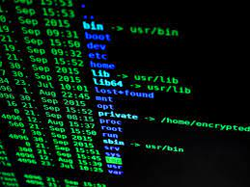


Abstract
CLI - YouTube is a command line interface tool that enables users to search, open, and download YouTube videos without using the YouTube API.
This lightweight and easy-to-use tool is designed for command line programmers who want to watch YouTube videos while programming on their terminal.

Slide 4
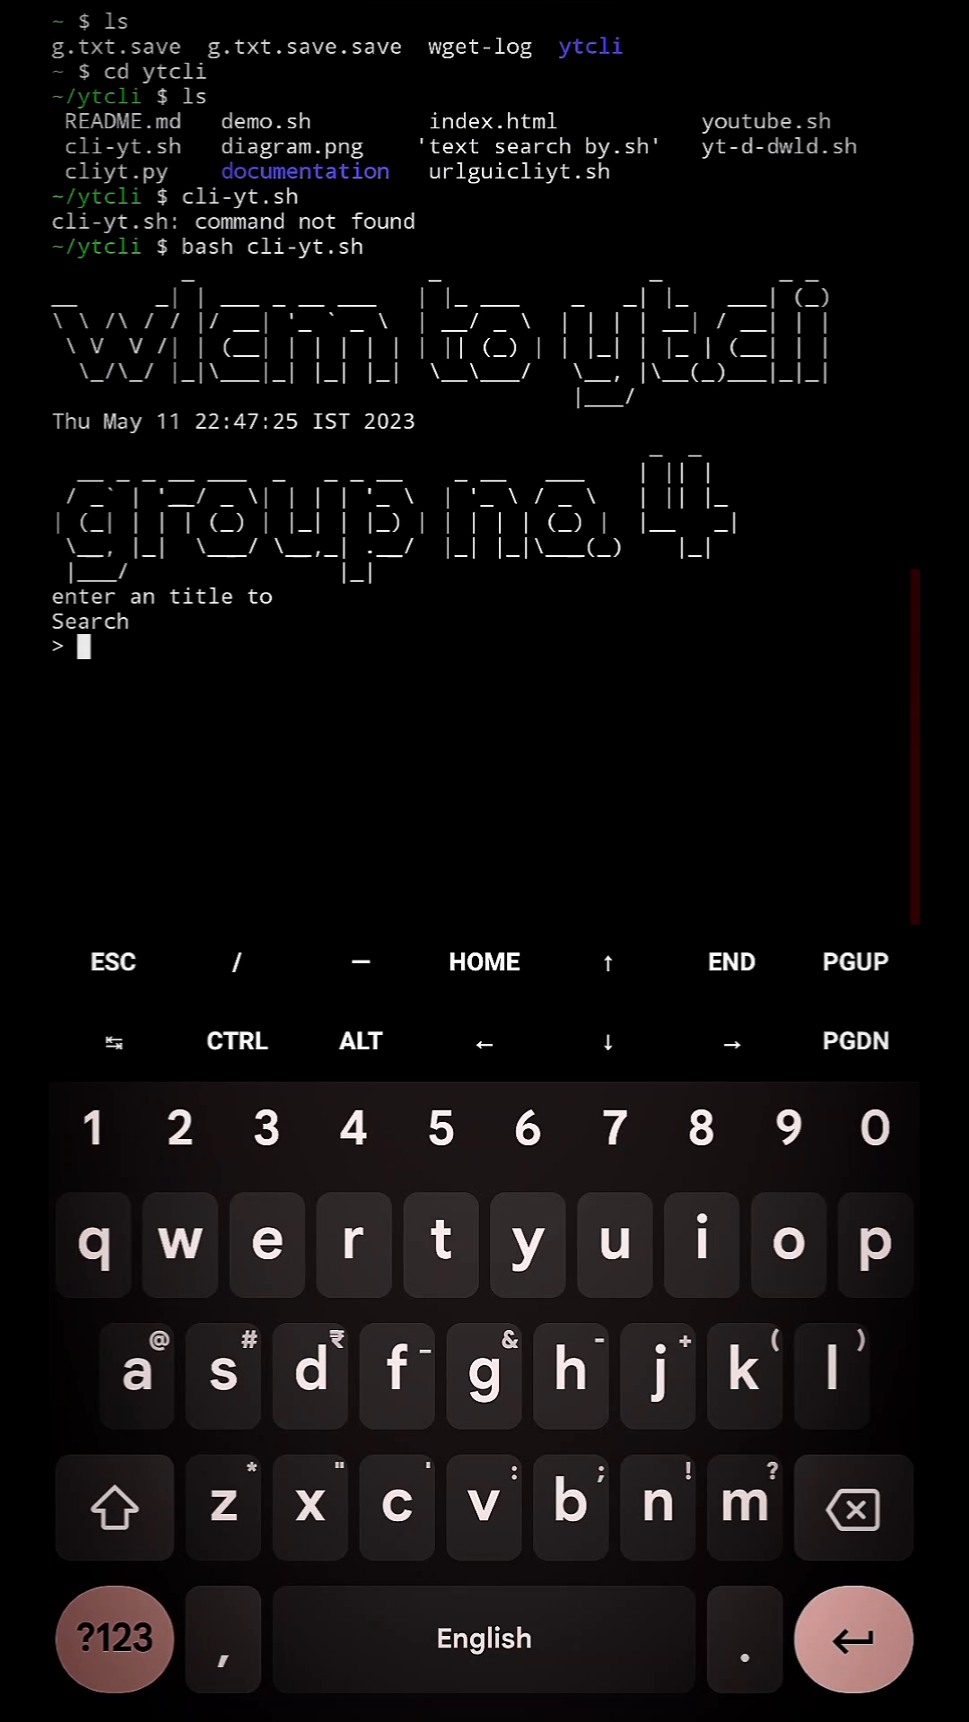
Introduction
YouTube is a popular video-sharing platform used by millions of people worldwide. While the YouTube API is available for developers to integrate with their applications, it has some limitations, such as requiring an API key and having limited access to data.
CLI - YouTube is a command line interface tool that offers a simple and efficient solution for searching, opening, and downloading YouTube videos without the use of the YouTube API. In this paper, we describe the design and implementation of CLI - YouTube.
video of program

Slide 5
Literature Review
In the context of the "cli-yt" project, a CLI tool could be a useful addition to a developer's toolkit, providing a way to interact with YouTube in a more efficient and flexible way than through a web browser or GUI-based application.
However, it is important to note that the use of CLI tools can have a learning curve and may not be suitable for all users.
More recently, there has been a resurgence of interest in CLI tools, driven in part by the growing popularity of DevOps practices and the need for tools that can be easily automated and scripted.
CLI tools are often used in conjunction with other software tools to perform tasks such as deployment, monitoring, and configuration management.

Slide 6
Research Paper
Our Research Supports via the following and related works :-
YT-Dl, "YouTube-Dl Documentation,"[Online]. Available:
https://github.com/ytdl-org/youtube-dl/blob/master/README.md
YouTube Developer Documentation." Google Developers,Google,2021,
https://developers.google.com/youtube
YouTube-DL:** A popular command-line program for downloading videos from YouTube and various other video sharing sites. You can find the official repository on GitHub at https://github.com/ytdl-org/youtube-dl
Our Paper is freely available to view and download at - https://0x0.st/HKOz.pdf

Slide 7
Literature Survey
Sr no. | Name of Paper | Author Name | Published date
1. | Command Line Interface Design for Interactive Visualization of Network Traffic | Saad Bin Saed | January 2019
2. | A Comparative Study of Command Line Interfaces in Operating Systems | A.S. Miah | July 2020
3. | Optimizing Command-Line Interface for Network Configuration and Management | M. Tanveer | 2018

Slide 8
Literature Survey
Sr no. | Name of Paper | Author Name | Published date
4. | A Task-Centric Approach to Designing Command-Line Interfaces | Htet Htet Aung | January 2002
5. | Youtube - DL Documentation | Ricardo Garcia Gonzalez | January 14 , 2006
3. | "Web Scraping Tools: A Survey." Journal of Information Processing Systems | Piyush Kumar Jaiswal | February 20, 2018

Slide 9
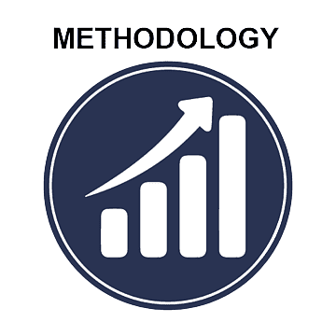

Proposed Methodology
However, here are some general steps that could be followed:
Define the scope and requirements of the CLI tool. This involves determining what tasks the tool should be able to perform, what data it will need to access, and what output it should provide to users.
Select a programming language and framework for developing the CLI tool. Popular choices include Python, Node.js, and Ruby, each of which has libraries and tools specifically designed for building CLI applications.
Design the user interface for the CLI tool. This involves determining what commands and arguments the tool will accept, how users will input data, and what feedback the tool will provide to users.

Slide 10
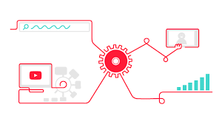



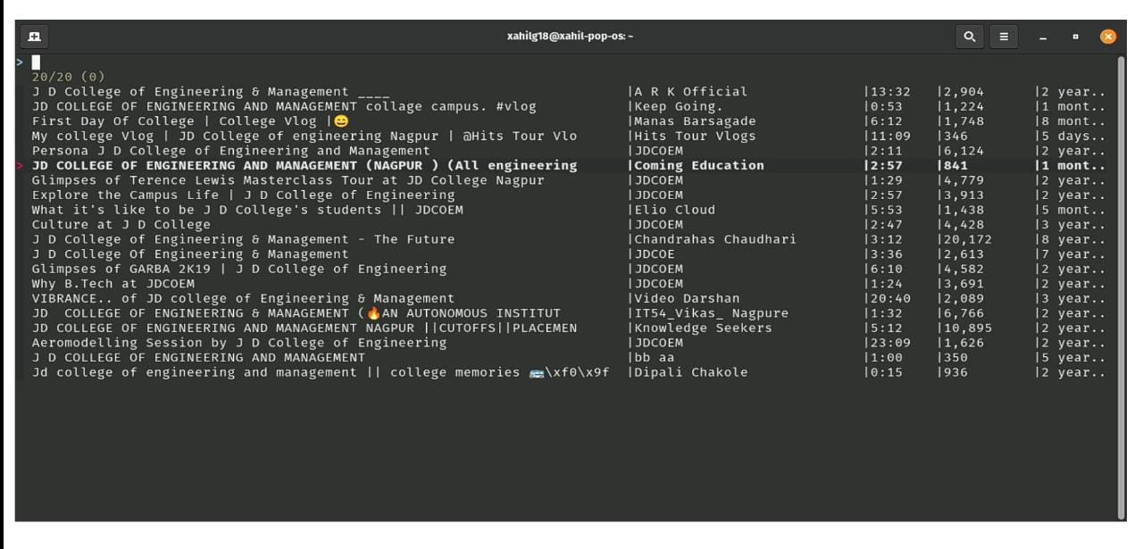
Flowchart :
YouTube API
YouTube Instances
( hosted individuosly )
Ytdl web scrapper
Video starts playing
Response and Features fetching

Slide 11

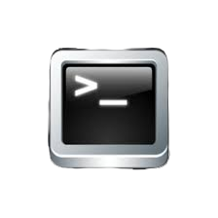


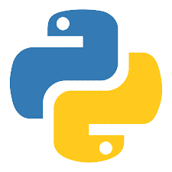
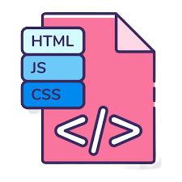

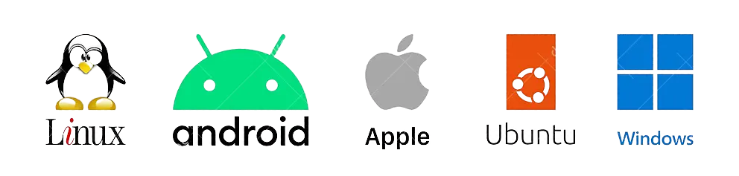
Vscode
Google Cloud Collab
Github
Gnome Terminal
Programming Languages and Platform -
Python 3
Bash / shell language
HTML / CSS [ frontend ]
Youtube Search Query
Development Environment

Slide 12
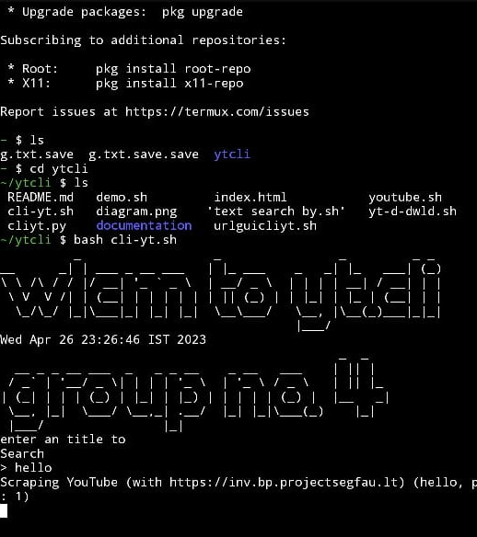
Result
It does not require an API key or registration, making it accessible to anyone.
It has minimum system requirements, making it lightweight and easy to use.
It uses less internet bandwidth compared to other tools.
Repurpose old computer and Hardwares.

Slide 13
Work Done and Snippets
[fig 3] Interface while searching and choosing video .

Slide 14
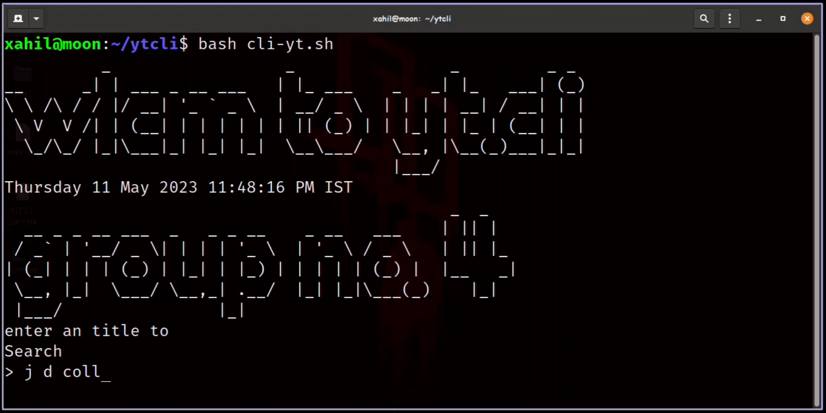
[fig 4 ] Video Representation of working [ linux ]

Slide 15
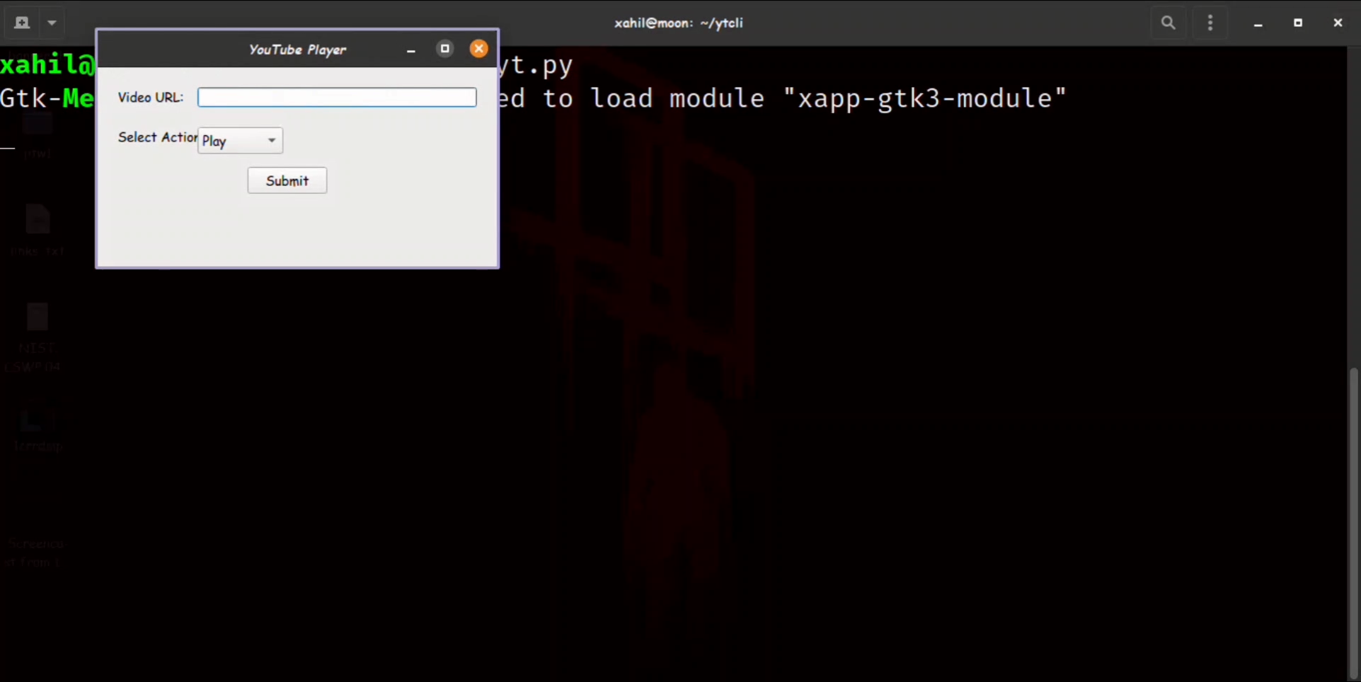
[fig 5 ] Planned Video Representation of working in python

Slide 16
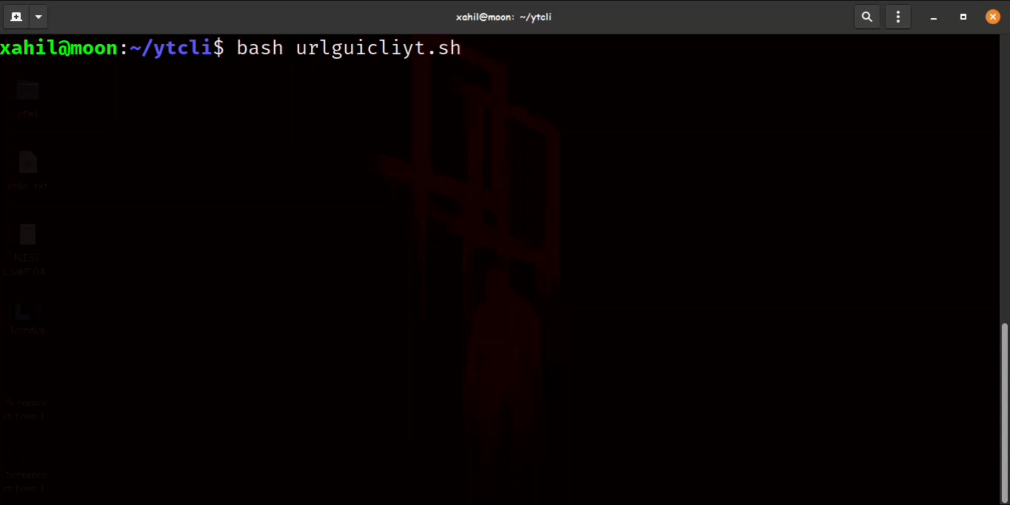
[fig 6] Video Representation of working in gui linux for download

Slide 17
Conclusion
CLI - YouTube is a useful tool for accessing and downloading YouTube videos without the use of the YouTube API.
Its simple and efficient design makes it an attractive option for command line programmers who want to watch YouTube videos while programming on their terminal.
CLI - YouTube offers several advantages, such as not requiring an API key or registration, minimum system requirements , and using less internet bandwidth compared to other tools .

Slide 18
Future Scope
Video Encoding : Cutting Some parts of the video in play to be encoded
Video Quality Modification
Fetch and download support
Sponsorblock Support
Remote integration with KdeConnect / GsConnect and Seamless operation
Embedded system installation
Android Support

Slide 19
References
"YouTube Developer Documentation." Google Developers,Google,2021, https://developers.google.com/youtube
Bilal, Muhammad, et al. "A Systematic Review of YouTube Research in Computer Science Education." Education and Information Technologies, vol.25, no. 6, 2020, pp. 5333- 5364.
Python, "Python Software Foundation," [Online]. Available: https://www.python.org/
The Linux Documentation Project, "What is the Linux Documentation Project?," [Online]. Available: https://www.tldp.org/

Slide 20
Thank you !

